Slide 1

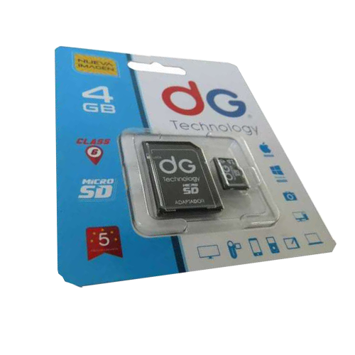
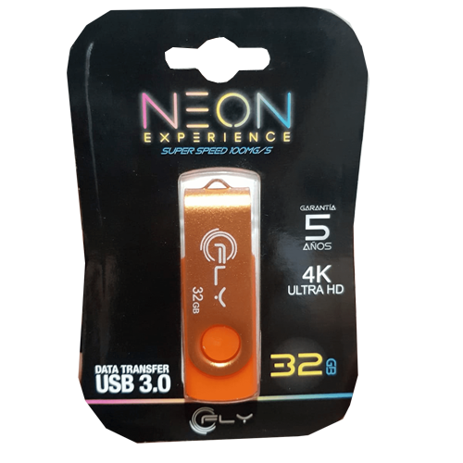
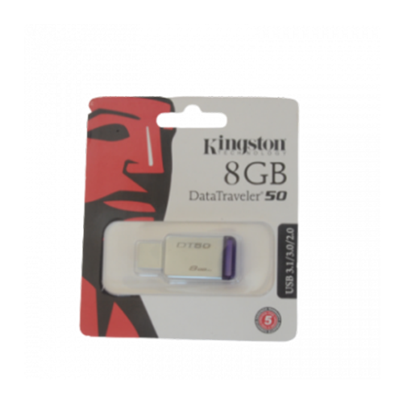
CATALOGO DE MEMORIAS MICRO SD Y USB
MAKROTECNO
Tecnologia a tu alcance

Slide 2
MEMORIAS USB

Slide 3
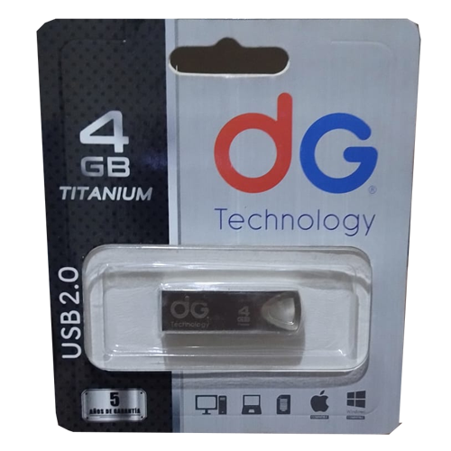
MEMORIAS USB
MEMORIA USB DG TECHNOLOGY 4GB REF: MU-DG1
$ 16.000

Slide 4
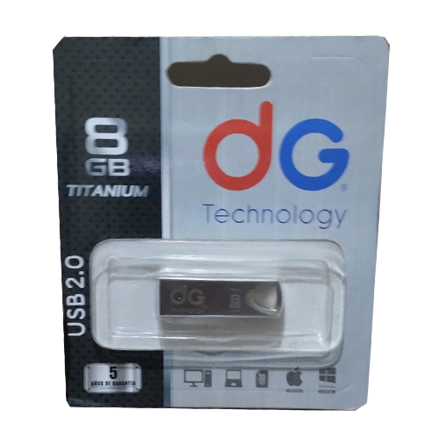
MEMORIAS USB
MEMORIA USB DG TECHNOLOGY 8GB REF: MU-DG2
$ 20.000

Slide 5
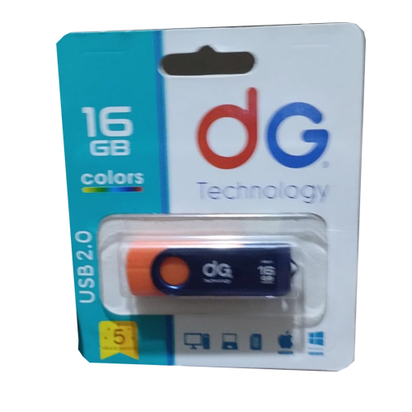
MEMORIAS USB
MEMORIA USB DG TECHNOLOGY 16GB REF: MU-DG3
$ 25.000

Slide 6
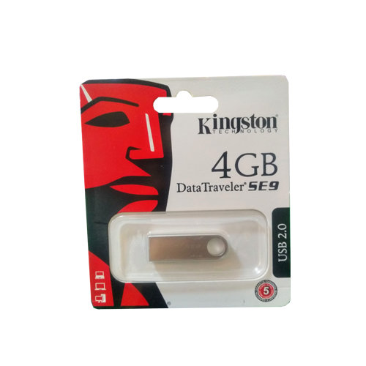
MEMORIAS USB
MEMORIA USB KINGSTON 4GB REF: MU-KG1
$ 16.000

Slide 7
MEMORIAS USB
MEMORIA USB KINGSTON 8GB REF: MU-KG2
$ 20.000

Slide 8
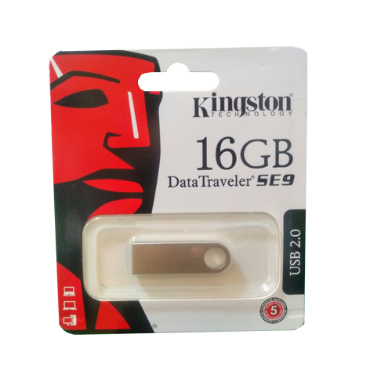
MEMORIAS USB
MEMORIA USB KINGSTON 16GB REF: MU-KG3
$ 24.000

Slide 9
MEMORIAS USB
MEMORIA USB NEON 32GB REF: MU-NN4
$ 30.000

Slide 10
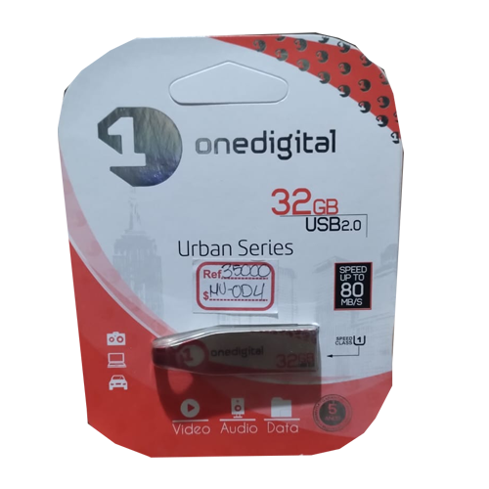
MEMORIAS USB
MEMORIA USB ONE DIGITAL 32GB REF: MU-OD4
$ 30.000

Slide 11
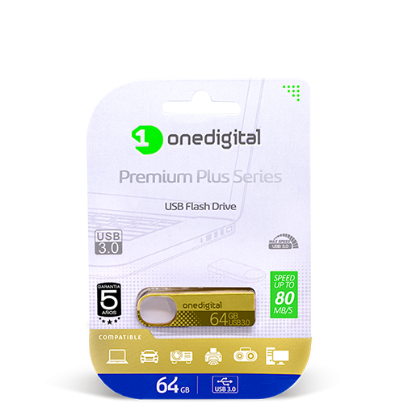
MEMORIAS USB
MEMORIA USB ONE DIGITAL 64GB REF: MU-OD5
$ 45.000

Slide 12
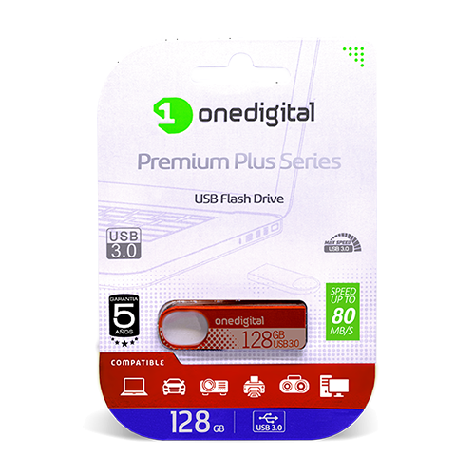
MEMORIAS USB
MEMORIA USB ONE DIGITAL 128GB REF: MU-OD6
$ 100.000

Slide 13
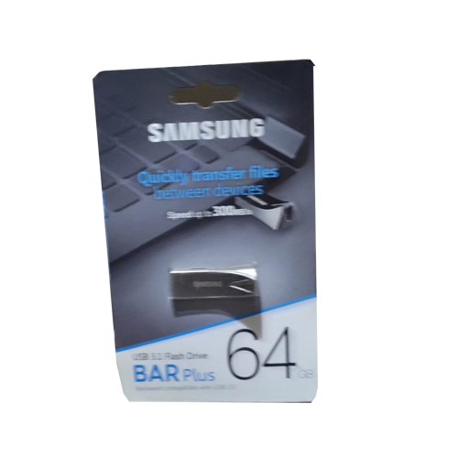
MEMORIAS USB
MEMORIA USB SAMSUNG 64GB REF: MU-SG5
$ 45.000

Slide 14
MEMORIAS USB
MEMORIA USB SAMSUNG 64GB REF: MU-SG5
$ 45.000

Slide 15
MEMORIAS MICRO SD

Slide 16
MEMORIAS MICRO SD
MEMORIA MICRO SD DG TECHNOLOGY 4GB REF: MM-DG1
$ 16.000

Slide 17
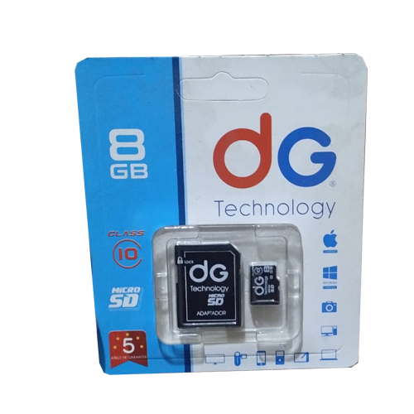
MEMORIAS MICRO SD
MEMORIA MICRO SD DG TECHNOLOGY 8GB REF: MM-DG2
$ 20.000

Slide 18
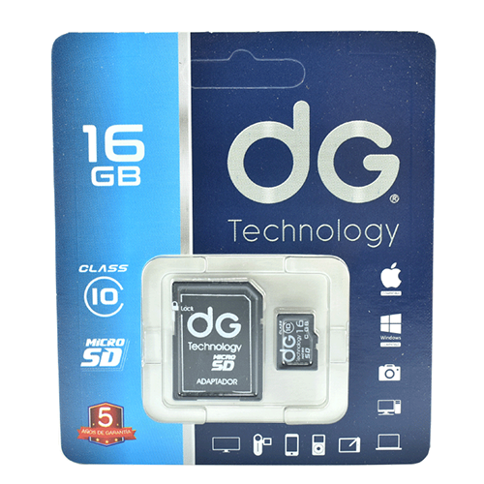
MEMORIAS MICRO SD
MEMORIA MICRO SD DG TECHNOLOGY DE 16GB REF: MM-DG3
$ 26.000

Slide 19
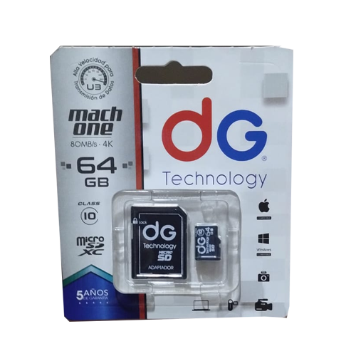
MEMORIAS MICRO SD
MEMORIA MICRO SD DG DIGITAL 64GB REF: MM-DG5
$ 40.000

Slide 20
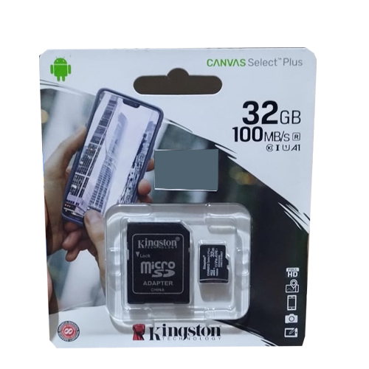
MEMORIAS MICRO SD
MEMORIA MICRO SD KINGSTON ORIGINAL 32GB REF: MM-KGO4
$ 35.000

Slide 21
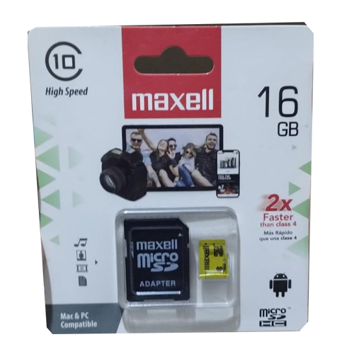
MEMORIAS MICRO SD
MEMORIA MICRO SD MAXELL 16GB REF: MM-MX3
$ 25.000

Slide 22
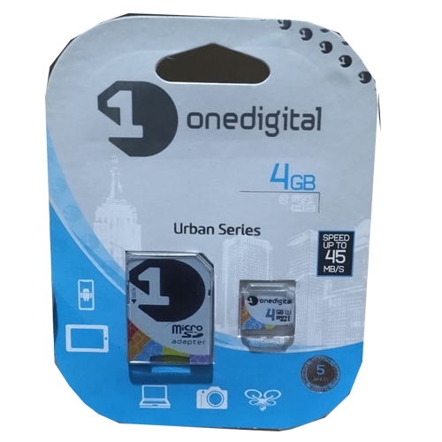
MEMORIAS MICRO SD
MEMORIA MICRO SD ONE DIGITAL 4GB REF: MM-OD1
$ 16.000

Slide 23
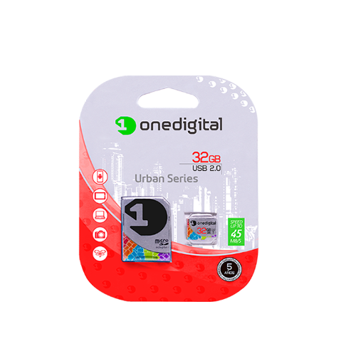
MEMORIAS MICRO SD
MEMORIA MICRO SD ONE DIGITAL 32GB REF: MM-OD4
$ 35.000

Slide 24
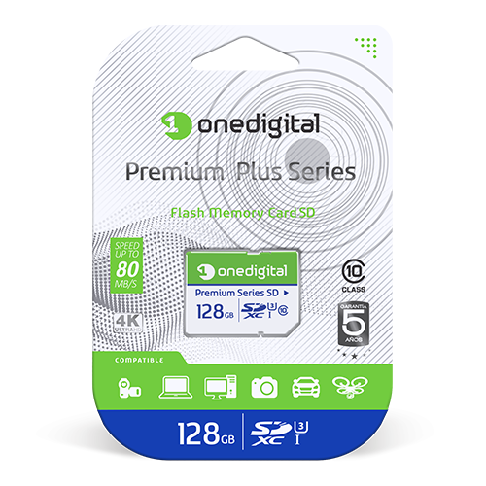
MEMORIAS MICRO SD
MEMORIA MICRO SD ONE DIGITAL 128GB REF: MM-OD6
$ 80.000

Slide 25
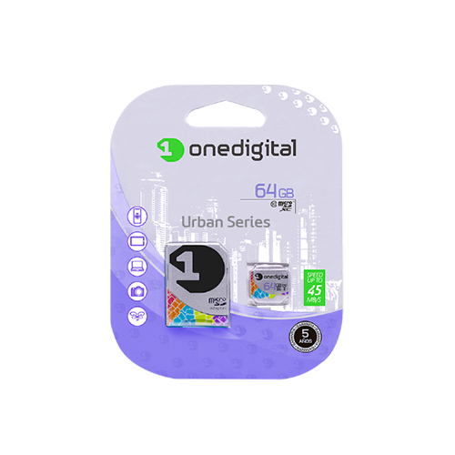
MEMORIAS MICRO SD
MEMORIA MICRO SD ONE DIGITAL 64GB REF: MM-OD5
$ 45.000

Slide 26
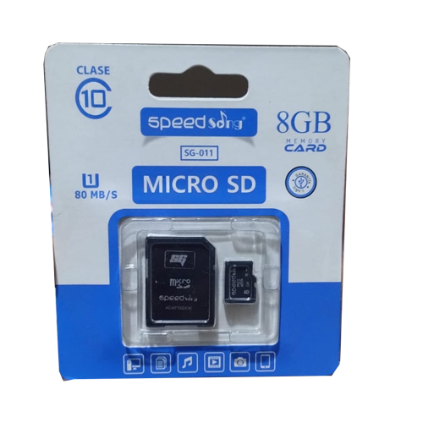
MEMORIAS MICRO SD
MEMORIA MICRO SD SPEEND SONG 8GB REF: MM-SS2
$ 20.000

